Slide 1
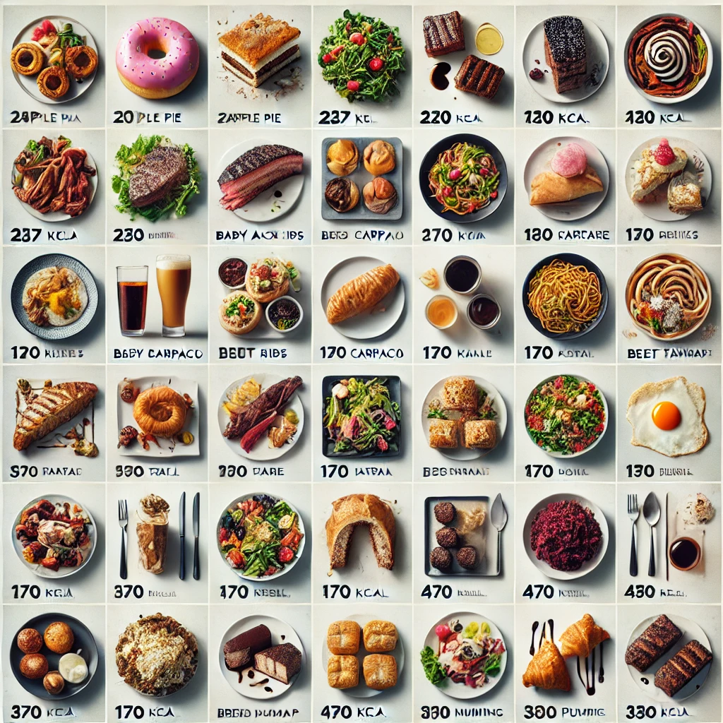
MEAL-GRAM
Food Calorie Estimator
BY
Lakshmi Sriya Amperayani
Jayasurya Murali
Veera Venkata Vijaya Subhash

Slide 2
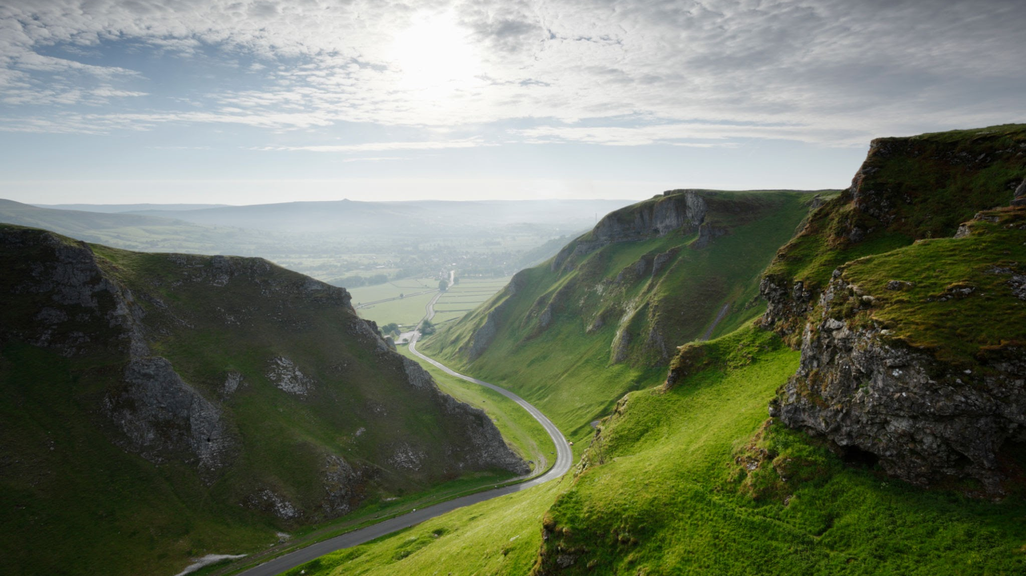
MealGram : An AI-powered Image-Based Food Calorie Estimator
The "MealGram" project develops an AI-powered tool to estimate the calorie content from food images using the Food-101 dataset.
MEAL GRAM
Section
12

Slide 3
Overview
Section
Section
12
What is the dataset used?
Q
Food-101 data set https://www.kaggle.com/datasets/dansbecker/food-101
A

Slide 4
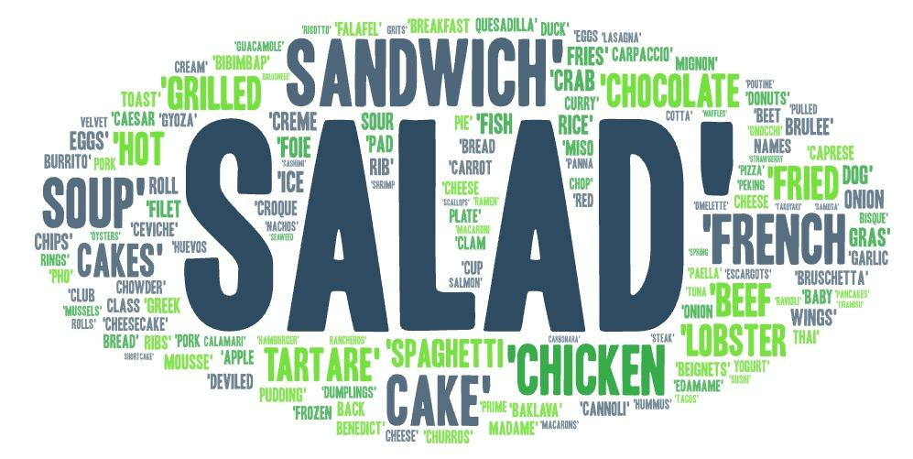
FOOD-101 DATASET
Food Calorie Estimator

Slide 5
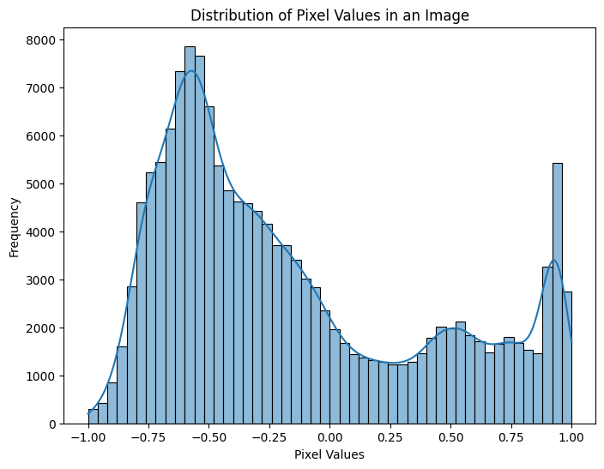
DISTRIBUTION OF PIXEL VALUES IN AN IMAGE

Slide 6
MODELING
MobileNetV2 is a convolutional neural network (CNN) architecture that is widely used for image classification, object detection, and other vision-related tasks.
It was introduced by Google researchers in 2018 as an improved version of the original MobileNetV1

Slide 7
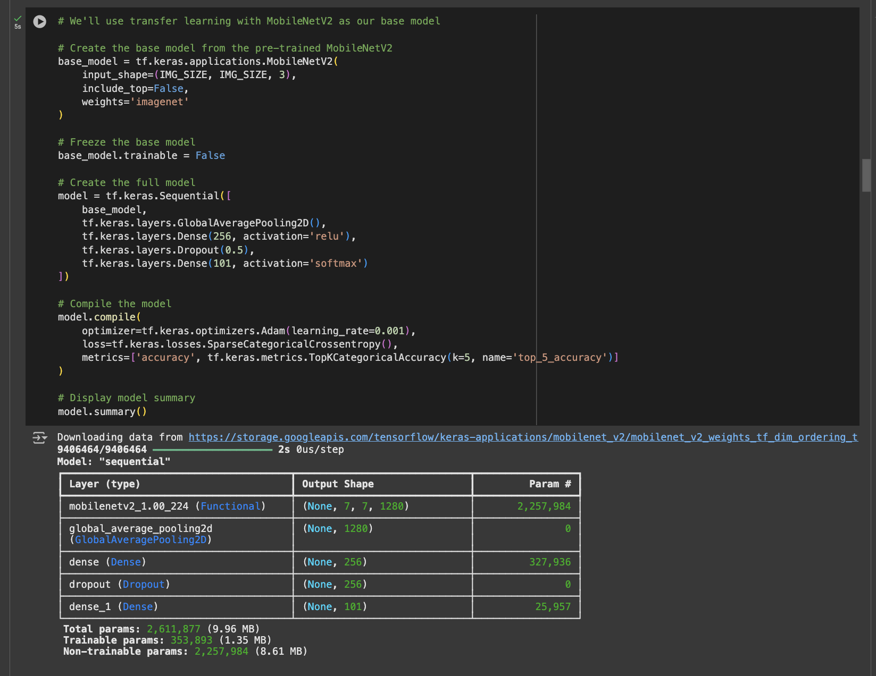
MODELING
MODEL TRAINED

Slide 8
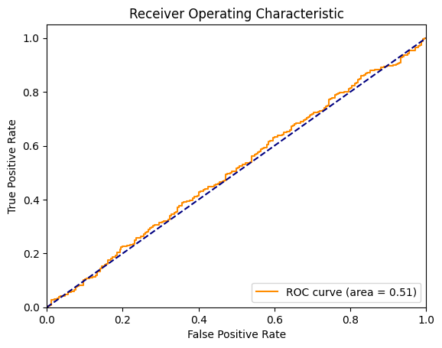
ROC CURVE

Slide 9
Accuracy
Epoch trained - 20 times
accuracy: 0.8103
loss: 0.6794
top_5_accuracy: 0.9541
val_accuracy: 0.6627
val_loss: 1.5885
val_top_5_accuracy: 0.8854

Slide 10
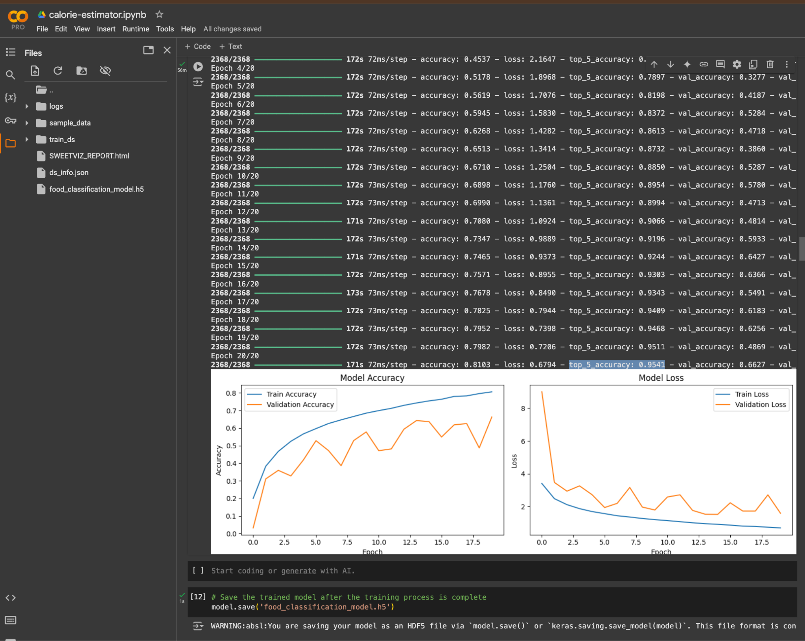
Accuracy Screenshot

Slide 11
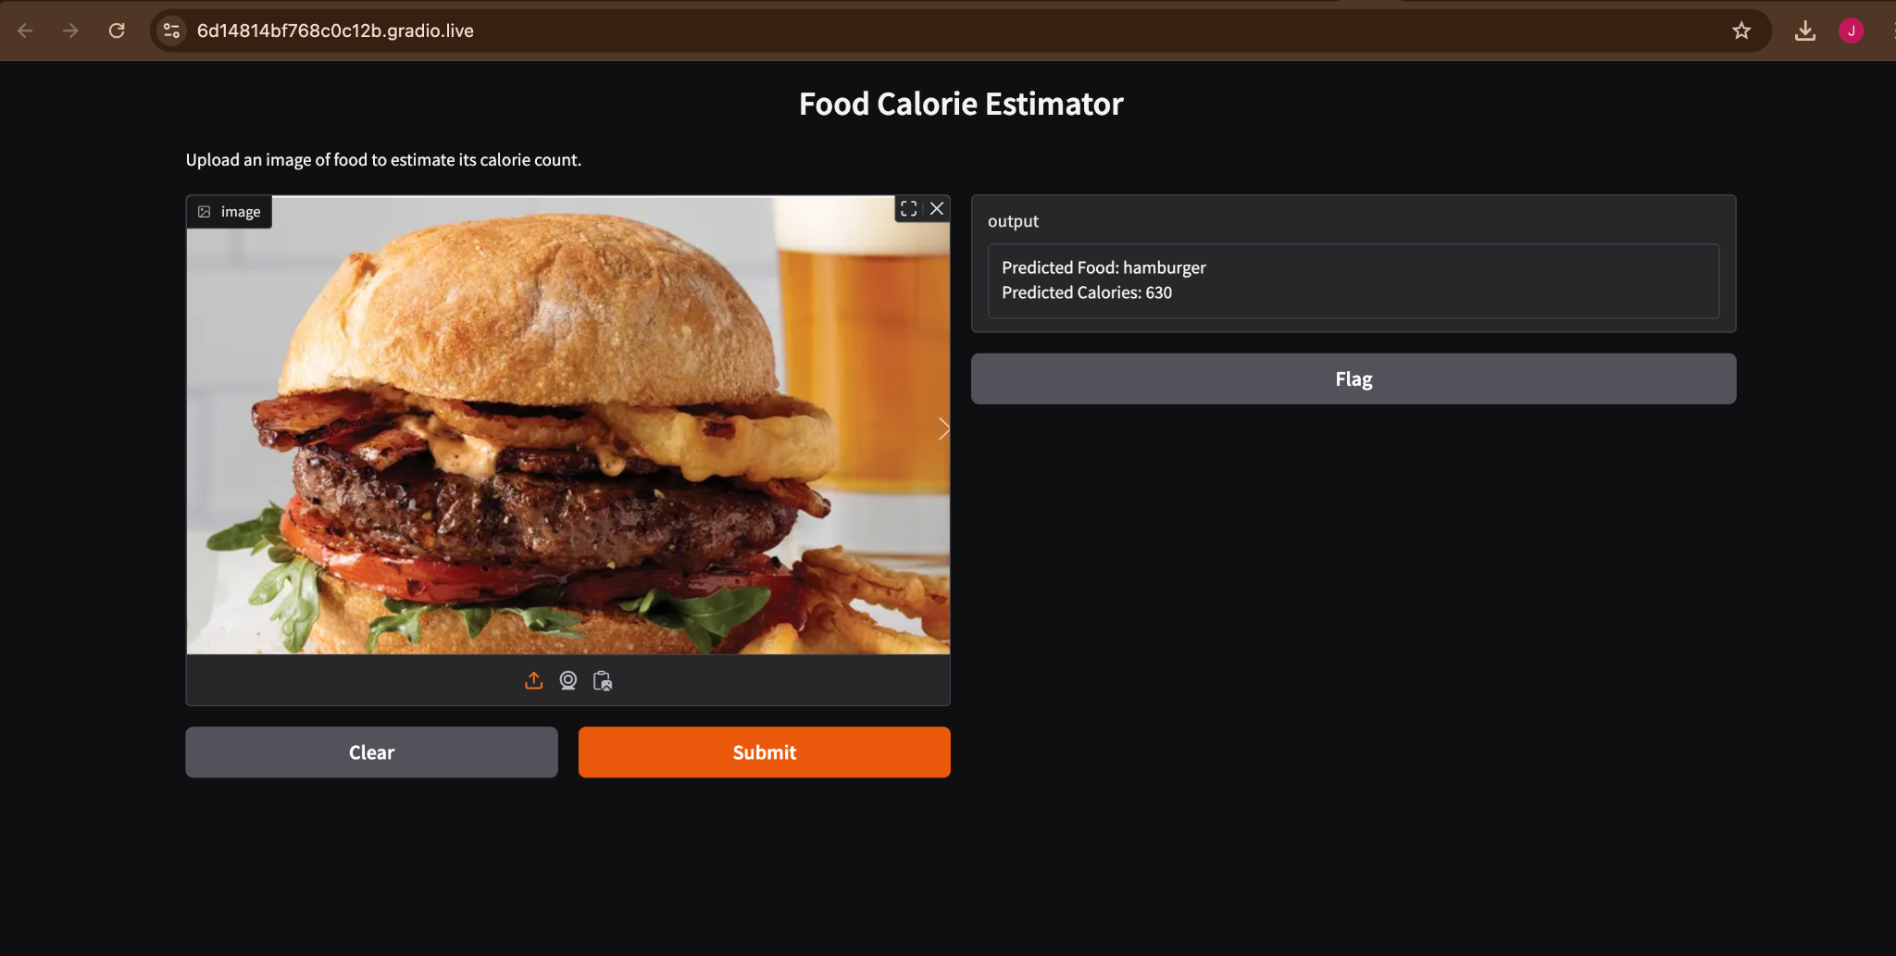
GRADIO DEPLOYMENT

Slide 12
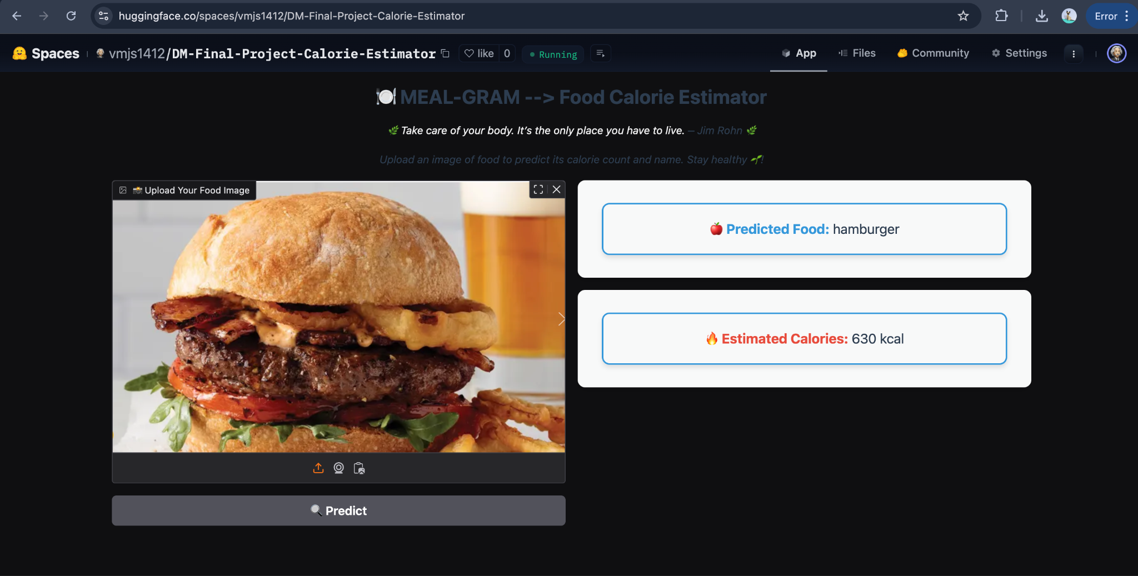
HUGGING FACE DEPLOYMENT
https://huggingface.co/spaces/vmjs1412/DM-Final-Project-Calorie-Estimator

Slide 13
THANK YOU
🌿
Take care of your body.
It’s the only place you have to live.
– Jim Rohn 🌿

